Slide 1
Chapter 6. Model Specification
6.1 Properties of the Sample Autocorrelation Functions
6.2 The Partial and Extended Autocorrelation Functions
6.3 Specification of Some Simulated Time Series
6.4 Nonstationarity
6.5 Other Specification Methods
6.6 Specification of Some Actual Time Series

Slide 2

6.1 Properties of the Sample Autocorrelation Functions
Definition
For the observed time series Y₁, Y₂, …, Y_{n}, the sample or estimated autocorrelation function is defined as
Our goal is to recognize, to the extent possible, patterns in r_{k} that are characteristic of the known patterns in ρ_{k} for common ARMA models.

Slide 3
6.1 Properties of the Sample Autocorrelation Functions
To facilitate the comparison of estimated correlations (r_{k}) with the theoretical correlations (ρ_{k}), we need to investigate the sampling properties of r_{k} for k = 1, 2, … .
Suppose that
where the e_{t} are independent and identically distributed with zero means and finite, nonzero, common variance.
We assume further that
(These will be satisfied by an stationary ARMA model.)

Slide 4
6.1 Properties of the Sample Autocorrelation Functions
With the assumptions (6.1.2) and (6.1.3), for any fixed m, the joint distribution of
approaches, as n → ∞, a joint normal distribution with zero means, variances c_{jj}, and covariances c_{ij}, where

Slide 5
6.1 Properties of the Sample Autocorrelation Functions
For large n, r_{k} is approximately normally distributed with mean ρ_{k} and variance c_{kk} /n. Furthermore,
Notice that the approximate variance of r_{k} is inversely proportional to the sample size, but Corr(r_{k}, r_{j}) is approximately constant for large n.

Slide 6
6.1 Properties of the Sample Autocorrelation Functions
For some special cases, Eq. (6.1.4) can be simplified.
Case 1:
Suppose that {Y_{t}} is white noise. Then Eq. (6.1.4) reduces considerably, and we obtain, for large n,
Case 2:
Suppose that {Y_{t}} is generated by an AR(1) process with ρ_{k} = φ^{k} for k > 0. Then, after considerable algebra and summing several geometric series, Eq. (6.1.4) with i = j yields, for large n,

Slide 7
6.1 Properties of the Sample Autocorrelation Functions
In particular,
Notice that the closer φ is to ±1, the more precise our estimate of ρ₁ (= φ) becomes.
For large lags, the terms in Eq. (6.1.6) involving φ^{k} may be ignored, and we have

Slide 8
6.1 Properties of the Sample Autocorrelation Functions
In contrast to Eq. (6.1.7), values of φ close to ±1 imply large variances for r_{k}. Thus we should not expect nearly as precise estimates of ρ_{k} = φ^{k} ≈ 0 for large k as we do of ρ_{k} = φ^{k} for small k.
For general 0 < i < j, Eq. (6.1.4) can be simplified (after much algebra) as

Slide 9
6.1 Properties of the Sample Autocorrelation Functions
Based on Eqs. (6.1.6) to (6.1.10), we have Exhibit 6.1.
Exhibit 6.1 Large Sample Results for Selected r_{k} from an AR(1) Model
φ |  |  | Corr(r₁, r₂)
±0.9 | 0.44/√n | 0.807/√n | ±0.97 | 2.44/√n
±0.7 | 0.71/√n | 1.12/√n | ±0.89 | 1.70/√n
±0.4 | 0.92/√n | 1.11/√n | ±0.66 | 1.18/√n
±0.2 | 0.98/√n | 1.04/√n | ±0.38 | 1.04/√n

Slide 10
6.1 Properties of the Sample Autocorrelation Functions
Case 3:
In the case of the MA(1) model, Eq. (6.1.4) can be simplified as follows
Furthermore,

Slide 11
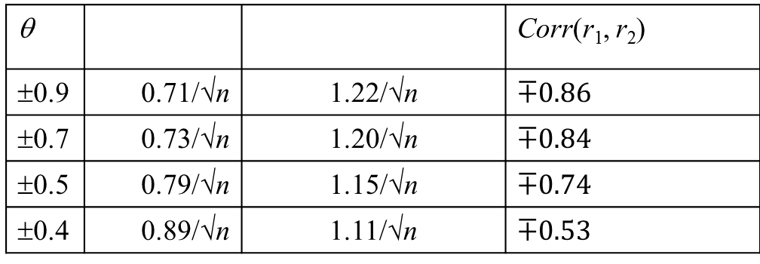
6.1 Properties of the Sample Autocorrelation Functions
Exhibit 6.2 Large Sample Results for Selected r_{k} from an MA(1) Model
θ |  |  | Corr(r₁, r₂)
±0.9 | 0.71/√n | 1.22/√n
±0.7 | 0.73/√n | 1.20/√n
±0.5 | 0.79/√n | 1.15/√n
±0.3 | 0.89/√n | 1.07/√n

Slide 12
6.1 Properties of the Sample Autocorrelation Functions
Case 4:
For the general MA(q) model, with i = j = k, Eq. (6.1.4) reduces to
so that,
The estimated standard deviation (or standard error) of r_{k} for large lags (k > q) can be obtained by replacing ρ’s with r’s in Eq. (6.1.14) and then taking the square root.

Slide 13
6.2 The Partial and Extended Autocorrelation Functions
The autocorrelation functions are NOT useful for determining the order of an AR(p) model since the ACFs of the AR(p) model do not become 0 after certain number of lags – they die off rather than cut off.
A function is defined as the correlation between Y_{t} and Y_{t–k} after removing the effect of the intervening variables Y_{t–1}, Y_{t–2}, …, Y_{t–k+1} can help to determine the order of autoregressive models. Such function is called the partial autocorrelation function (PACF) (to be defined later) at lag k.

Slide 14
6.2 The Partial and Extended Autocorrelation Functions
Consider predicting Y_{t} based on a linear function of the intervening variables Y_{t–1}, Y_{t–2}, …, Y_{t–k+1}, say
β₁Y_{t–1} + β₂Y_{t–2} + .... + β_{k−1}Y_{t–k+1}, with β’s chosen to minimize the mean square error of prediction.
If we assume that β’s have been so chosen and then think backward in time, it follows from stationarity that the best “predictor” of Y_{t–k} based on the same Y_{t–1}, Y_{t–2}, …, Y_{t–k+1} will be β₁Y_{t–k+1} + .... + β_{k−1}Y_{t–1}.

Slide 15
6.2 The Partial and Extended Autocorrelation Functions
The partial autocorrelation function at lag k is then defined to be the correlation between the prediction errors; that is,
by convention, we take φ₁₁ = ρ₁.
If {Y_{t}} is a normally distributed time series, then
That is, φ_{kk} is the correlation in the bivariate distribution of Y_{t} and Y_{t–k} conditional on Y_{t–1}, Y_{t–2}, …, Y_{t–k+1}.

Slide 16
6.2 The Partial and Extended Autocorrelation Functions
Example
The best linear prediction of Y_{t} based on Y_{t–1} alone is just ρ₁Y_{t–1}. Thus, according to Eq. (6.2.1), we obtain
Therefore,

Slide 17
6.2 The Partial and Extended Autocorrelation Functions
Consider now an AR(1) model. Recall ρ_{k} = φ^{k} so that
In general, we have φ_{kk} = 0 for all k> 1.
Thus the partial autocorrelation is nonzero for lag 1, the order of the AR(1) process, but is zero for all lags greater than 1.

Slide 18
6.2 The Partial and Extended Autocorrelation Functions
Theorem 6.2.1
For a general AR(p) model, the partial autocorrelation function φ_{kk} = 0 for all k > p.
Proof
It will be shown in Chapter 9 that the best linear predictor of Y_{t} based on a linear function of the variables
Y_{t–1}, Y_{t–2}, …, Y_{p} , …, Y_{t–k+1} for k > p is φ₁Y_{t–1} + φ₂Y_{t–2} + .... + φ_{p}Y_{t–p}. Also, the best linear predictor of Y_{t–k} is some function of Y_{t–1}, Y_{t–2}, …, Y_{p} , …, Y_{t–k+1}, call it
h(Y_{t–1}, Y_{t–2}, …, Y_{p} , …, Y_{t–k+1}). So, the covariance between the prediction errors is

Slide 19
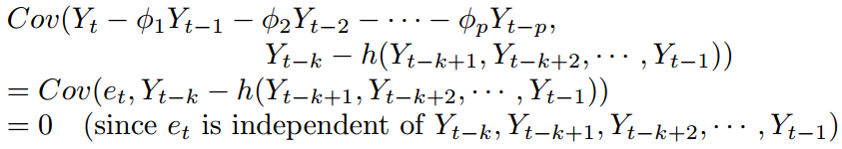
6.2 The Partial and Extended Autocorrelation Functions
Thus, we have proved the theorem. ♦

Slide 20


6.2 The Partial and Extended Autocorrelation Functions
For an MA(1) model, Eq. (6.2.3) quickly yields
Furthermore, for the MA(1) case, it may be shown that

Slide 21
6.2 The Partial and Extended Autocorrelation Functions
For the MA(q) model, it can be shown that the partial autocorrelation behaves very much like the autocorrelation of an AR(q) model – the partial autocorrelation never equals to zero but essentially decays to zero exponentially fast as the lag increases.

Slide 22
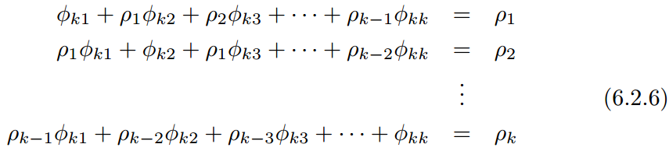
6.2 The Partial and Extended Autocorrelation Functions
A general method for finding the partial autocorrelation function for any stationary process with autocorrelation function ρ_{k} is as follows. For a given lag k , it can be shown that φ_{kk} satisfy
More explicitly, we have
Here, we are treating ρ_{k} as given and wish to solve for φ_{k1}, φ_{k2}, …, φ_{kk}.

Slide 23
6.2 The Partial and Extended Autocorrelation Functions
Note:
In the case of the AR(p) process, for k = p, Eq. (6.2.6) is just the Yule-Walker equation (4.3.25), so φ_{pp} = φ_{p}.

Slide 24
6.2 The Partial and Extended Autocorrelation Functions
The Sample Partial Autocorrelation Function
Given the relationships in Eq. (6.2.6), the estimate of φ_{kk} is obtained by replacing the ρ’s with their estimates r’s. We call the corresponding estimate of φ_{kk} the sample partial autocorrelation function (sample PACF) and denote it by .
Levinson (1947) and Durbin (1960) gave an efficient method for obtaining the solution to Eq. (6.2.6) for either theoretical or sample partial autocorrelations as follows:

Slide 25

6.2 The Partial and Extended Autocorrelation Functions
where
Quenoulle (1949) has shown that, under the hypothesis that an AR(p) model is correct, the sample PACF at lags greater than p are approximately normally distributed with zero means and variances 1/n.
Thus, for k > p, ±2/√n can be used as critical limits on to test the null hypothesis that an AR(p) model is correct.

Slide 26
6.2 The Partial and Extended Autocorrelation Functions
General Behavior of the ACF and PACF for ARMA Models
 | AR(p) | MA(q) | ARMA(p, q), p > 0 and q > 0
ACF | Tails off | Cuts off after lag q | Tails off
PACF | Cuts off after lag p | Tails off | Tails off

Slide 27
6.2 The Partial and Extended Autocorrelation Functions
The Extended Autocorrelation Function
The ACF and PACF are not informative in determining the order of an ARMA model.
The EACF method uses the fact that if the AR part of a mixed ARMA model is known, “filtering out” the autoregression from the observed time series results in a pure MA process that enjoys the cutoff property in its ACF.
The derivation of EACF is relatively involved; see Tsay and Tiao (1984) for details. Yet the function is easy to use.

Slide 28
6.2 The Partial and Extended Autocorrelation Functions
The output of EACF is a two-way table, where the rows correspond to AR order p and the columns to MA order q. In general, for an ARMA(p, q) model, the order (p, q) of the model is identified by the upper left vertex of the triangle of “O”.

Slide 29
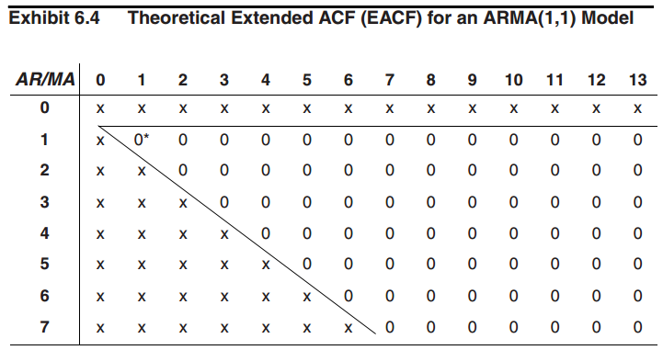
6.2 The Partial and Extended Autocorrelation Functions

Slide 30
6.3 Specifications of Some Simulated Time Series
MA(1) Process with θ = 0.9
Sample Size (n) = 120.
Exhibit 6.5: Based on Eq. (6.1.5), the approximate standard error is 1/√n. The dashed horizontal lines, plotted at ±2/√n = ±0.1826, are intended to give critical values for testing whether or not the autocorrelation coefficients are significantly different from zero. Notice that the sample ACF values exceed these rough critical values at lags 1, 5 and 14. Of course, the true autocorrelations at lags 5 and 14 are both 0.

Slide 31
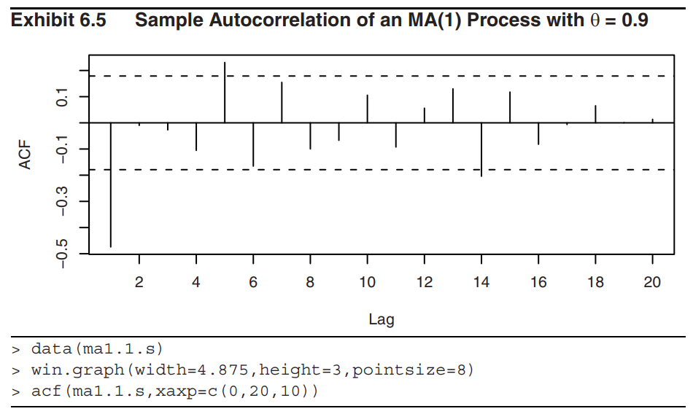
6.3 Specifications of Some Simulated Time Series

Slide 32
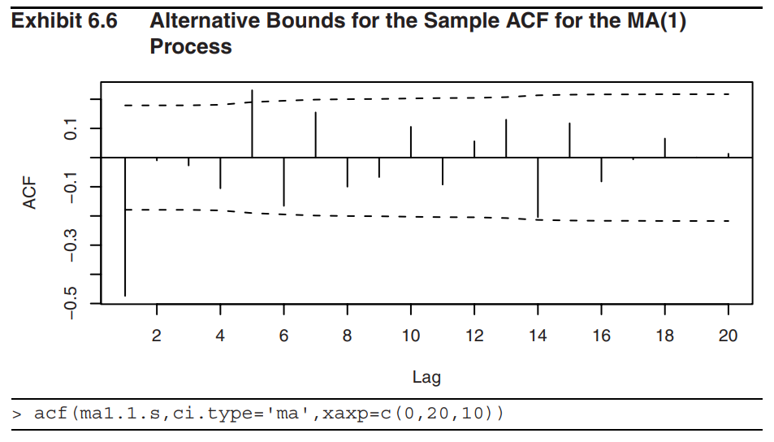
6.3 Specifications of Some Simulated Time Series

Slide 33
6.3 Specifications of Some Simulated Time Series
Exhibit 6.6: The same sample ACF but with critical bounds based on the more complex standard errors implied by Eq (6.1.14) (standard error = ±(2c_{kk})/√n by replacing ρ’s by r’s and then letting q = 1, 2, 3, … successively). Now the sample ACF value at lag 14 is insignificant and the one at lag 5 is just barely significant. The lag 1 autocorrelation is still highly significant.
Exhibits 6.5 and 6.6 lead us to consider an MA(1) model for this series. Remember that the model is tentative at this point and we would certainly want to consider other “nearby” alternative models when we carry out model diagnostics.

Slide 34
6.3 Specifications of Some Simulated Time Series
AR(1) Process with φ = 0.9
Exhibit 6.10: The positive sample ACF values at lags 1, 2, 3 reflect the strength of the lagged relationship. However, notice that the sample ACF decreases more linearly than exponentially as theory suggests. Also contrary to theory, the sample ACF goes to negative at lag 10 and remains so for many lags.
Exhibit 6.11: The sample partial autocorrelation (PACF) gives a much clearer picture about the nature of the AR(1) model.

Slide 35
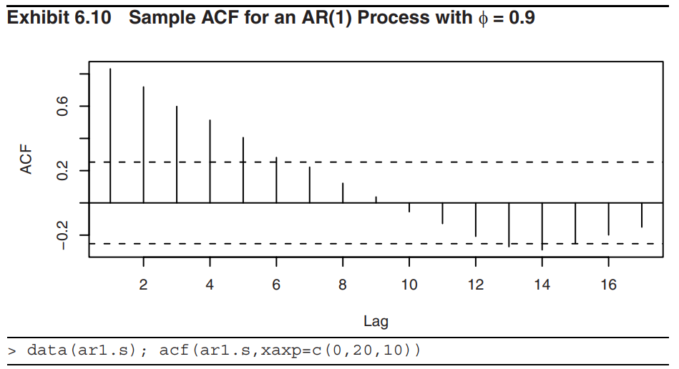
6.3 Specifications of Some Simulated Time Series

Slide 36
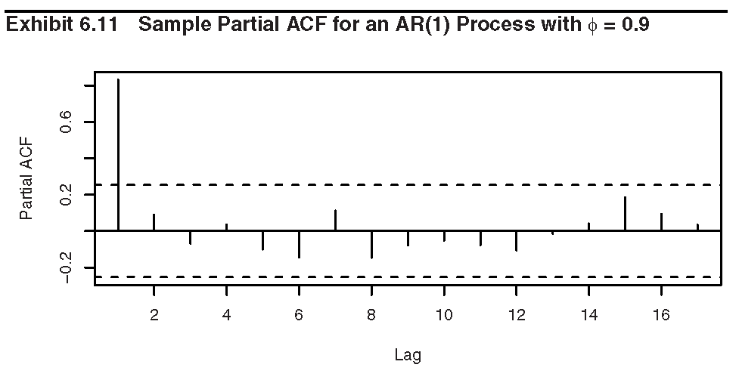
6.3 Specifications of Some Simulated Time Series

Slide 37
6.3 Specifications of Some Simulated Time Series
ARMA(1, 1) Process with φ = 0.6 and θ = − 0.3
Exhibits 6.15 & 6.16: The sample ACF and PACFs seem to indicate that an AR(1) model should be specified.
Exhibit 6.17: The triangular region of zeros shown in the sample EACF indicates quite clearly that an ARMA(p, q) model with q = 1 and with p =1 or 2 would be more appropriate.

Slide 38
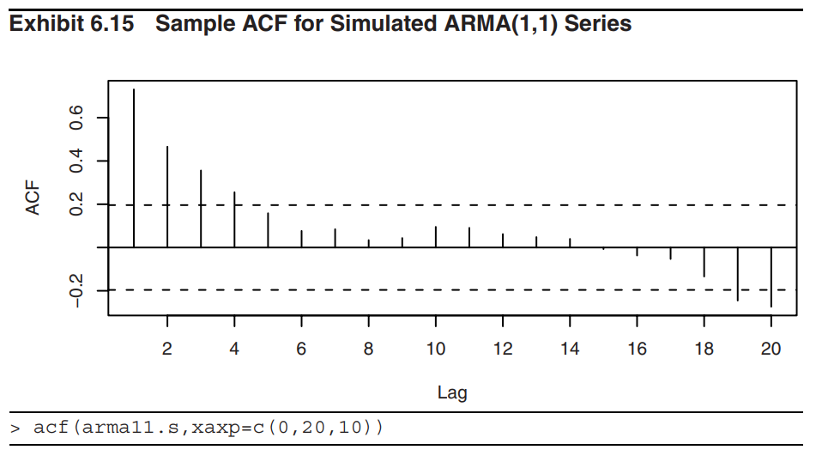
6.3 Specifications of Some Simulated Time Series

Slide 39
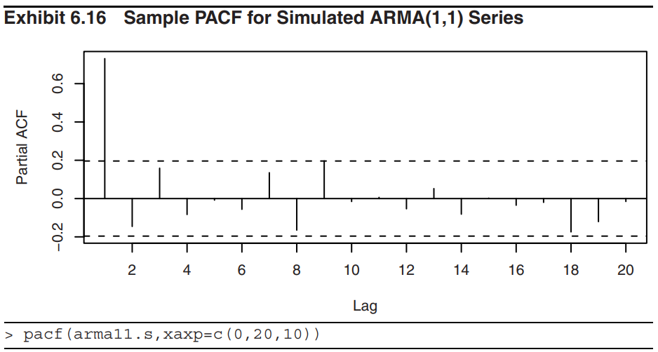
6.3 Specifications of Some Simulated Time Series

Slide 40
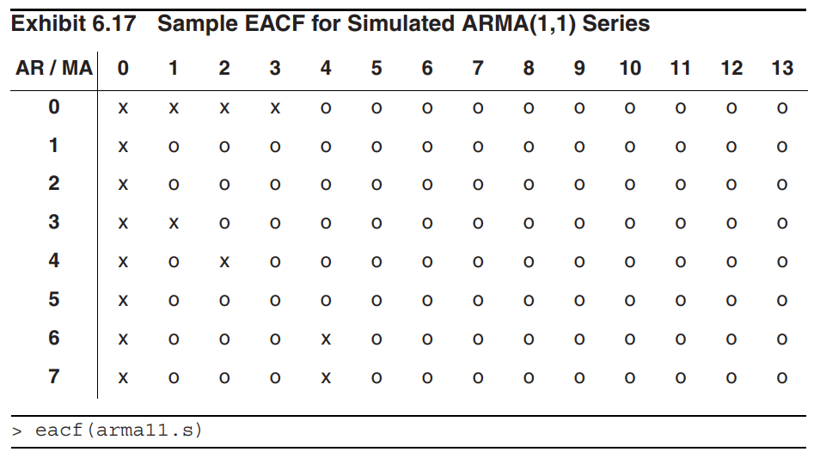
6.3 Specifications of Some Simulated Time Series

Slide 41
6.4 Nonstationarity
For nonstationary series, the sample ACF typically fails to die out rapidly as the lags increases. This is due to the tendency for nonstationary series to drift slowly, either up or down, with apparent “trends”.
Exhibits 6.18 shows the sample ACF for the logarithms of the oil price time series. All values shown are “significantly far from 0” and the only pattern is perhaps a linear decrease with increasing lag.
Exhibit 6.19 shows the sample ACF computed on the first differences of the logs of the oil price series. The pattern emerges much more clearly an MA(1) model seems appropriate. Thus, the original model is IMA(1,1) model.

Slide 42
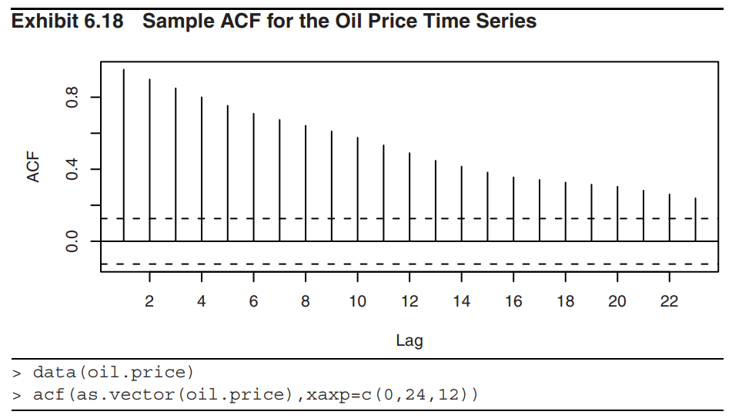
6.4 Nonstationarity

Slide 43
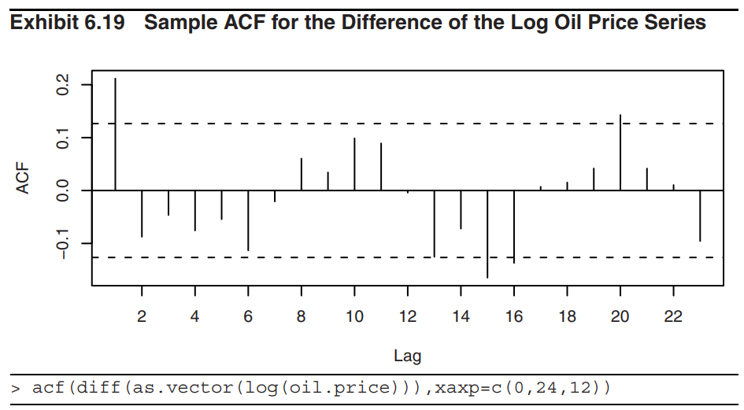
6.4 Nonstationarity

Slide 44
6.4 Nonstationarity
Overdifferencing
The difference of any stationary time series is also stationary.
Overdifferencing introduces unnecessary parameters and correlations into a series.
Overdifferencing creates a noninvertible model. Noninvertible models create serious problems when we attempt to estimate their parameters (see Chapter 7).

Slide 45
6.4 Nonstationarity
Example
Suppose our observed series, {Y_{t}}, is in fact a random walk (can be thought as an IMA(1, 1) model with θ = 0) so that one difference would lead to a very simple white noise model
However, if we difference once more (that is , overdifference) we have
which is an MA(1) model but with θ = 1. If we take two differences here we unnecessarily have to estimate the unknown value of θ. Specifying an IMA(2, 1) model would not be appropriate here.

Slide 46
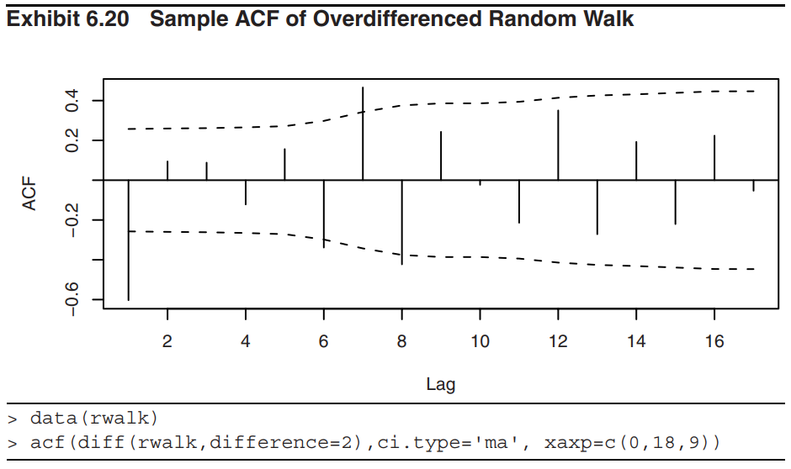
6.4 Nonstationarity

Slide 47
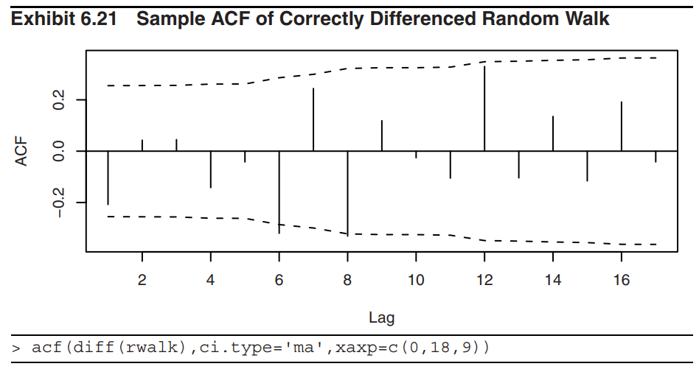
6.4 Nonstationarity

Slide 48
6.4 Nonstationarity
Based on Exhibit 6.20, we would likely specify at least an IMA(2, 1) model for the original series and then estimate the unnecessary MA parameter. We also have a significant sample ACF value at lag 7 to think about and deal with.
Exhibit 6.21 displays the sample ACF of the first difference of the random walk series – looks very much like white noise.

Slide 49
6.4 Nonstationarity
The (Augmented) Dickey-Fuller Unit-Root Test
Consider the model
where {X_{t}} is a stationary process.
The process {Y_{t}} is nonstationary if the coefficient α = 1, but it is stationary if |α| < 1.
Null hypothesis: H₀: α = 1 (Y_{t} is difference nonstationary)
Alternative hypothesis: H₁: α < 1
The process being difference nonstationary means that the process is nonstationary but becomes stationary after first differencing.

Slide 50
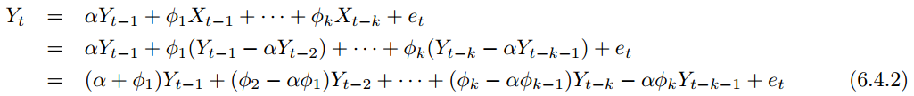
6.4 Nonstationarity
Suppose that {X_{t}} is an AR(k) process:
Eq. (6.4.1) can be written as
Now, {Y_{t}}is an AR(k + 1) process whose AR characteristic equation is given by

Slide 51
6.4 Nonstationarity
The corresponding null and alternative hypothesis can be restated as:
H₀: The AR characteristic polynomial (6.4.3) has a unit root
H₁: The AR characteristic polynomial (6.4.3) has no unit roots
From Eq. (6.4.2), we have
Let a = α – 1.

Slide 52
6.4 Nonstationarity
The null hypothesis that α = 1 can be tested by regressing the first difference of the observed time series on lag 1 of the observed series and on the past k lags of the first difference of the observed series. We then test whether the coefficient a = 0.
The augmented Dickey-Fuller (ADF) test statistic is the t-statistic of the estimated coefficient of a from the method of least squares regression. However, the ADF test statistic is not approximately t-distributed under the null hypothesis. A percentage points of this statistic have been tabulated (see Fuller (1996)).

Slide 53
6.5 Other Specification Methods
Akaike’s (1973) Information Criterion (AIC)
To select the model that minimizes
AIC = – 2log(maximum likelihood) + 2k (6.5.1)
where k = p + q + 1 if the model contains an intercept or constant term and k = p + q otherwise.
Remark
The maximum likelihood estimation is discussed in Chapter 7.
The addition of the term 2k serves as a “penalty function” to help ensure selection of parsimonious models and to avoid choosing models with too many parameters.

Slide 54
6.5 Other Specification Methods
AIC tends to be overfitting.
To counteract the overfitting tendency of the AIC, Hurvich and Tsai (1989) suggested a corrected AIC, denoted by AIC_{c} and defined by
where n is the (effective) sample size and again k is the total number of parameters as above.
Simulation results by Hurvich and Tsai (1989) suggest that for cases with k/n > 10%, the AIC_{c} outperforms many other model selection criteria, including both the AIC and BIC.

Slide 55
6.5 Other Specification Methods
Bayesian Information Criterion (BIC)
The BIC is another criterion that attempts to correct the overfitting tendency of the AIC.
To determine the ARMA orders is to select the model that minimizes the Schwartz Bayesian Information Criterion (BIC)
BIC = – 2log(maximum likelihood) + k log(n) (6.5.3)

Slide 56
6.5 Other Specification Methods
If the true process follows an ARMA(p, q) model, then it is known that the orders specified by minimizing the BIC are consistent; that is, they approach the true orders as the sample size increases.
In general, BIC does well at getting the correct order in large samples, whereas AIC tends to be superior in smaller samples where the relative number of parameters is large.

Slide 57
6.5 Other Specification Methods
Example
Exhibit 6.22 displays the pattern of which lags of the observed time series and which of the error process enter into the various best subset models of ARMA(12, 12).
Each row in the exhibit corresponds to a subset of ARMA(12, 12) model where the cells of the variables selected for the model are shaded.
The models are sorted according to their BIC, with better models (lower BIC) placed in higher rows and with darker shades.

Slide 58
6.5 Other Specification Methods
The Best Model:
Contains only lags 8 and 12 of the observed time series and lag 12 of the error process.
The Next Best Model:
Contains lag 12 of the time series and lag 12 of the errors.
The Third Best Model:
Contains lags 4, 8, and 12 of the time series and lag 12 of the errors.

Slide 59
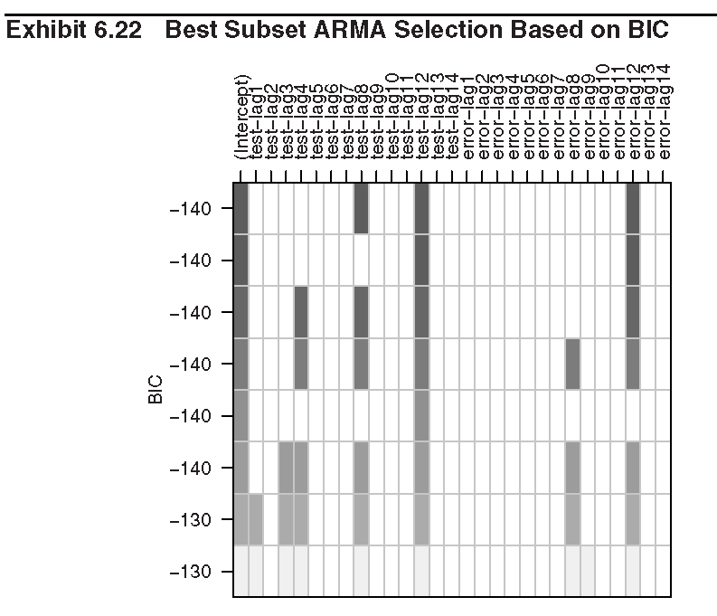
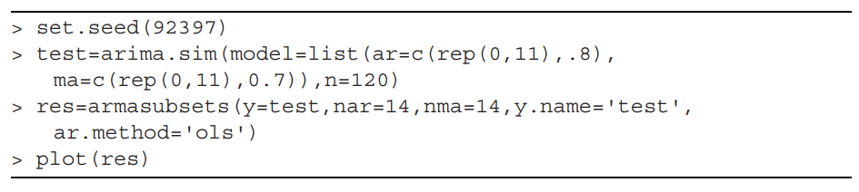
6.5 Other Specification Methods

Slide 60
6.6 Specification of Some Actual Time Series
The Oil Price Series
Source of the data: The oil price series in Exhibit 5.1.
The (Augmented) Dickey-Fuller unit root test to the logs of the original oil prices:
Test statistic: −1.1119
p-value: 0.9189
The series is nonstationary and the appropriateness of taking a difference of the logs.

Slide 61
6.6 Specification of Some Actual Time Series
The Oil Price Series
Exhibit 6.30:
Suggests an ARMA model with p = 0 and q = 1.
Exhibit 6.31:
Suggests to model in terms of Y_{t-1} and Y_{t-4} and that no lags are needed in the error terms. The second best model omits the lag 4 term so that an ARIMA(1,1,0) on the logarithms should be investigated further.
Exhibit 6.32:
Suggests MA(1) model
Exhibit 6.33:
Suggests AR(2) model

Slide 62
6.6 Specification of Some Actual Time Series
We will want to look at all of these models further when we estimate parameters and perform diagnostic tests in Chapters 7 and 8.

Slide 63
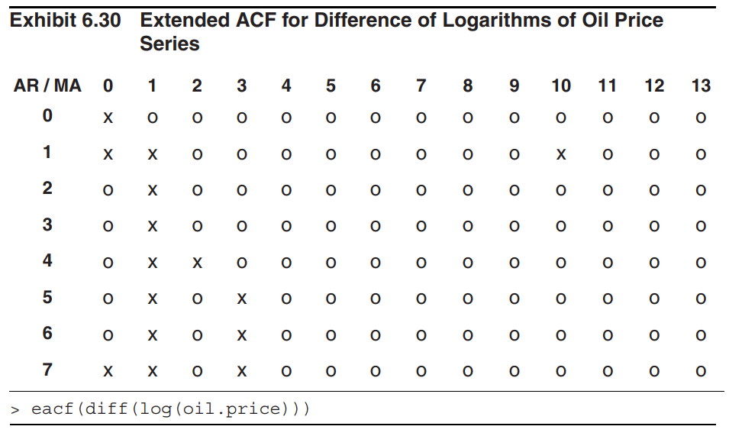
6.6 Specification of Some Actual Time Series

Slide 64
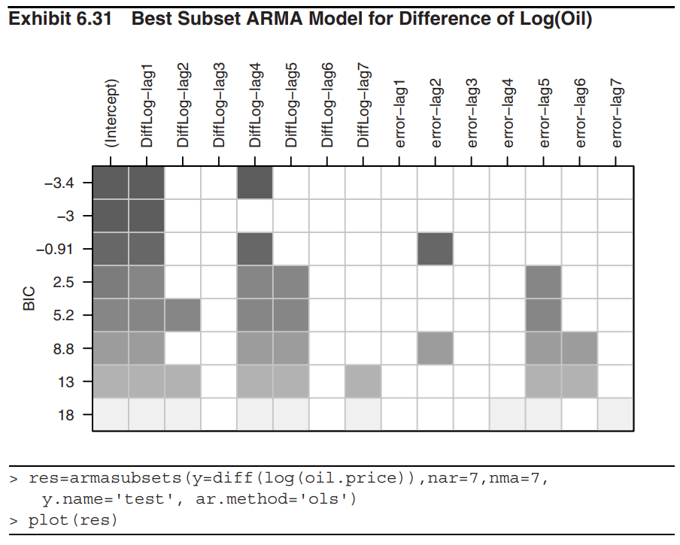
6.6 Specification of Some Actual Time Series

Slide 65
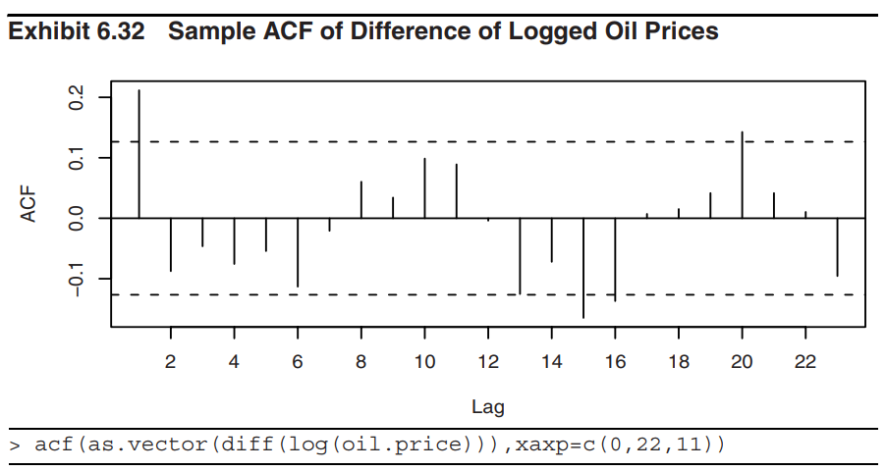
6.6 Specification of Some Actual Time Series

Slide 66
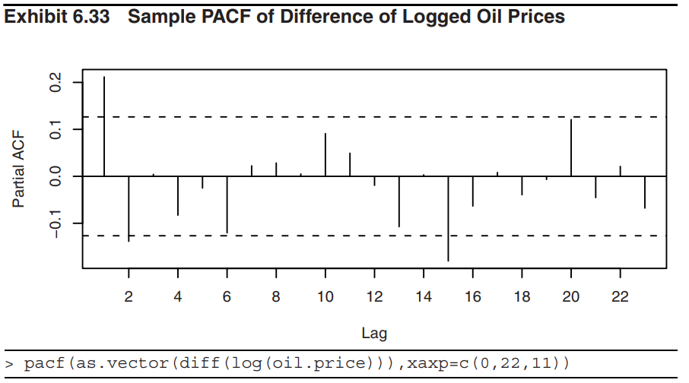
6.6 Specification of Some Actual Time Series

Slide 67
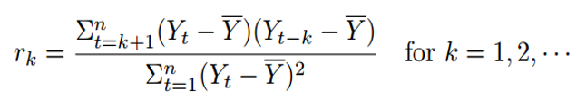
Summary
Sample autocorrelation functions
Partial autocorrelation functions
  A function is defined as the correlation between Y_{t} and Y_{t–k} after removing the effect of the intervening variables Y_{t–1}, Y_{t–2}, …, Y_{t–k+1}
  Theorem 6.2.1: For a general AR(p) model, the partial autocorrelation function φ_{kk} = 0 for all k > p.

Slide 68
Summary
General behavior of the ACF and PACF for ARMA models
Extended autocorrelation functions
  In general, for an ARMA(p, q) model, the order (p, q) of the model is identified by the upper left vertex of the triangle of “O”.
 | AR(p) | MA(q) | ARMA(p, q), p > 0 and q > 0
ACF | Tails off | Cuts off after lag q | Tails off
PACF | Cuts off after lag p | Tails off | Tails off

Slide 69
Summary
Other specification methods
  Information criteria: AIC, AIC_{C}, BIC
    AIC tends to be overfitting. AIC_{C} and BIC attempt to correct the overfitting tendency of the AIC
    In general, BIC does well in large samples, whereas AIC tends to be superior in smaller samples where the relative number of parameters if large.

Slide 70
Summary
Nonstationarity
  Test about nonstationarity:
    Sample ACF typically die out slowly as the lags increases.
    ADF test:
H₀: The AR characteristic polynomial has a unit root
H₁: The AR characteristic polynomial has no unit roots
  Remove nonstationarity
    Differencing (in general, d is at most 2)
  Overdifferencing
    The difference of any stationary time series is also stationary
    Overdifferencing introduces unnecessary parameters and correlations into a series
    Overdifferencing creates a noninvertible model

